Slide 1
Power System Fault Detection and Classification
CAPSTONE PROJECT
Presented By:
1. TANISHA CHOPRA – SG. BALEKUNDRI INSTITUTE OF TECHNOLOGY

Slide 2
OUTLINE
Problem Statement
Proposed System/Solution
System Development Approach
Algorithm & Deployment
Result (Output Image)
Conclusion
Future Scope
References

Slide 3
Problem Statement
Design a machine learning model to detect and classify different types of faults in a power distribution system. Using electrical measurement data (e.g., voltage and current phasors), the model should be able to distinguish between normal operating conditions and various fault conditions (such as line-to-ground, line-to-line, or three-phase faults). The objective is to enable rapid and accurate fault identification, which is crucial for maintaining power grid stability and reliability.

Slide 4
Proposed Solution
The system will use machine learning to detect and classify power system faults. It will help identify faults like Line-to-Ground, Line-to-Line, and Three-Phase quickly and accurately.
1. Data Collection: Historical data of voltage and current phasors will be used. The Kaggle fault dataset will be the main source.
2. Data Preprocessing: The data will be cleaned, normalized, and split into training and testing sets. Important features like voltage and current will be selected.
3. Machine Learning Model: A classification model such as Random Forest or SVM will be trained to predict fault types. The model will classify connections as Normal or Faulty (with specific fault types).
4. Deployment: A simple dashboard or app will be created to input values and display fault predictions. The system will be deployed on IBM Cloud.
5. Evaluation: The model will be evaluated using accuracy, precision, recall, and a confusion matrix. Results will show how well the model classifies each fault type. Let me know if you want this added to your report or abstract too!

Slide 5
System Approach
System Requirements:
Hardware Requirements:
Minimum 4 GB RAM (locally)
Stable internet connection (for IBM Cloud use)
IBM Cloud Requirements:
IBM Cloud Lite account (Free tier)
Watson Studio instance
Cloud Object Storage (for storing datasets)

Slide 6
Algorithm & Deployment
Algorithm
Algorithm Selection:
Random Forest is used for fault classification due to its accuracy, robustness, and ability to handle complex, multiclass data.
Data Input:
The model uses 41 features including voltage, current, angle, and phasor values. The target is the fault_type, such as:
Line-to-Ground
Line-to-Line
Three-Phase
Normal
Training Process:
Data is cleaned, normalized, and split (80/20). The model is trained using cross-validation and hyperparameter tuning to improve accuracy.
Prediction Process:
Real-time input data is passed into the trained model, which predicts the fault type with a confidence score.

Slide 7
Algorithm & Deployment
Deployment
Platform:
The model is deployed using IBM Cloud services:
Watson Studio (training)
Cloud Object Storage (data)
Watson Machine Learning (deployment)
Steps:
Upload and train the model in Watson Studio.
Deploy it as a REST API using Watson Machine Learning.
Use test data or a web app to send inputs and receive fault predictions.

Slide 8
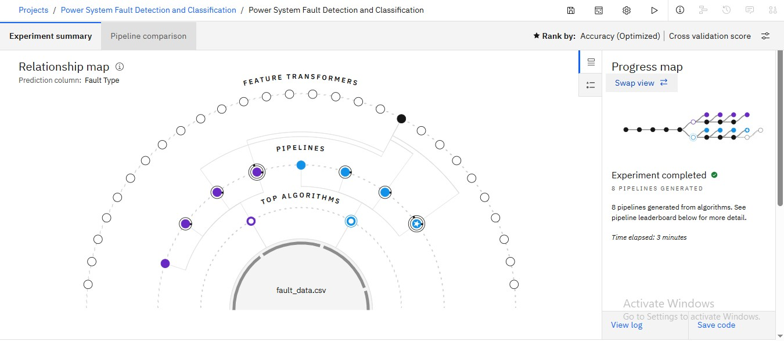
Result

Slide 9
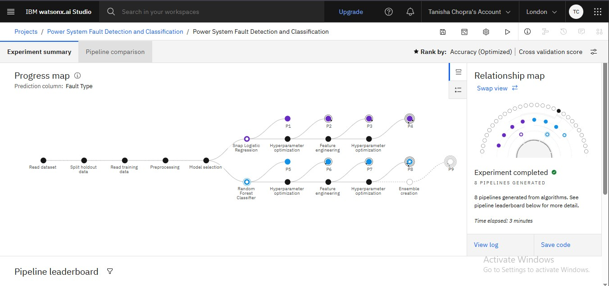
Result

Slide 10
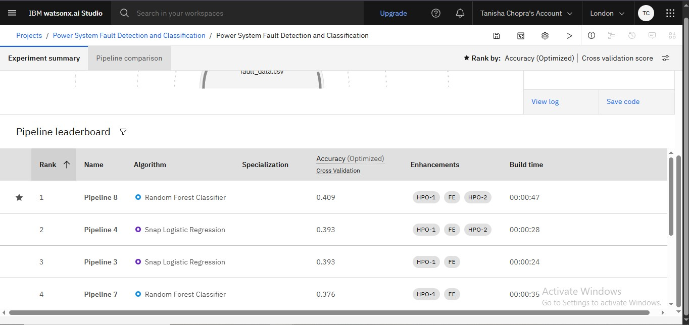
Result

Slide 11
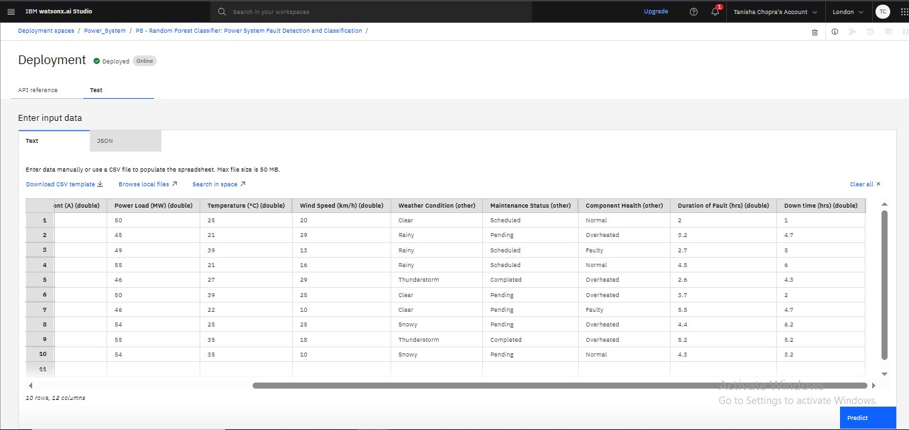
Result

Slide 12
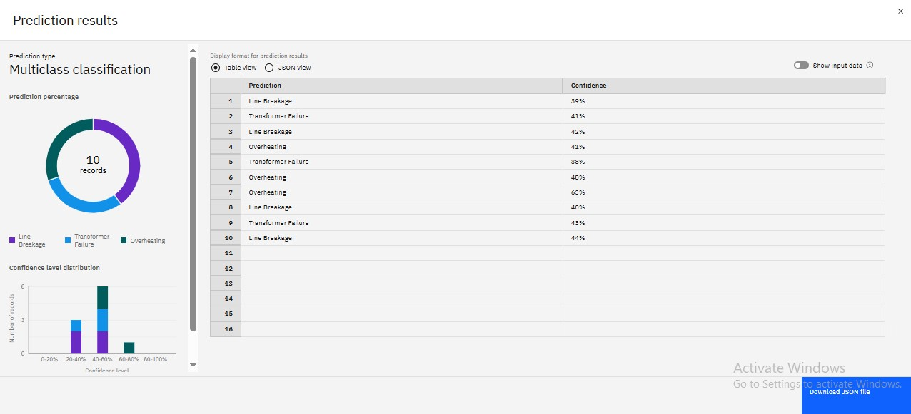
Result

Slide 13
Conclusion
The proposed machine learning-based system successfully detects and classifies different types of power system faults using real-time electrical data. By leveraging algorithms like Random Forest and deploying the model on IBM Cloud, the system ensures fast and accurate fault identification, which is essential for maintaining power grid stability and reducing downtime. The cloud-based deployment also supports scalability, accessibility, and integration with smart grid infrastructure.

Slide 14
Future scope
Integrate the system with real-time IoT sensors in smart grids.
Extend the model to predict fault severity and recovery time.
Include deep learning methods like LSTM for better fault prediction in dynamic environments.
Build a mobile/web dashboard for real-time monitoring and alerts.
Improve the model with more diverse datasets from various regions or seasons.

Slide 15
References
Kaggle – Power System Faults Dataset https://www.kaggle.com/datasets/ziya07/power-system-faults-dataset
IBM Cloud Docs – Watson Studio https://www.ibm.com/cloud/watson-studio
IBM Cloud - Watson Studio https://www.ibm.com/cloud/watson-studio
Scikit-learn Documentation – Random Forest Classifier https://scikitlearn.org/stable/modules/generated/sklearn.ensemble.RandomForestClassifier.html
IBM Cloud - Watson Machine Learning https://www.ibm.com/cloud/machine-learning

Slide 16
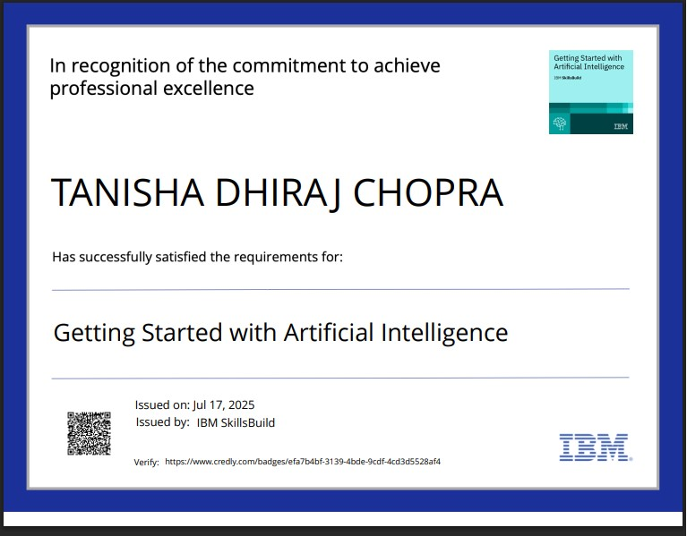
IBM Certifications

Slide 17
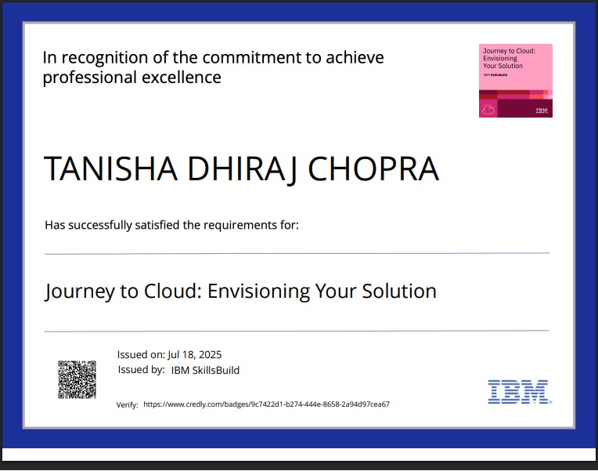
IBM Certifications

Slide 18
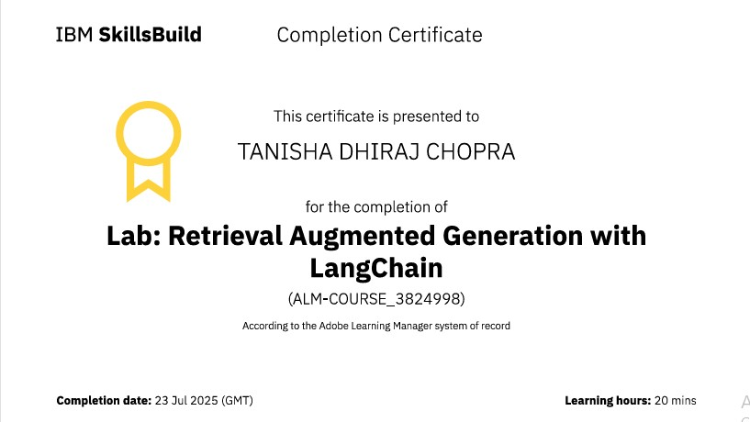
IBM Certifications

Slide 19
THANK YOU

